Slide 1
Mapping the EU LNG Terminal Landscape
Barbara Jinks
Gas Infrastructure Europe
11 September, London

Slide 2
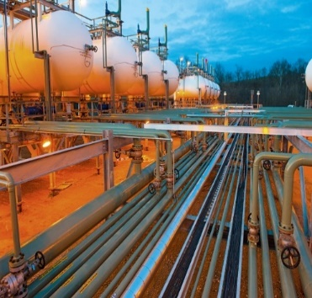
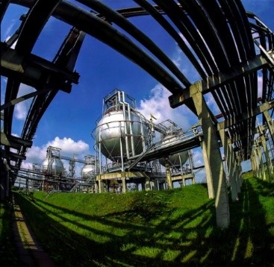
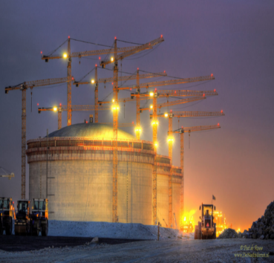
GIE – the European association for gas
infrastructure operators
We represent the mid-stream gas infrastructure business with
70 members in 26 European countries:

Slide 3
Meet our GLE members
16
9
member companies
countries
1
90%
observer
of the EU LNG import capacity

Slide 4
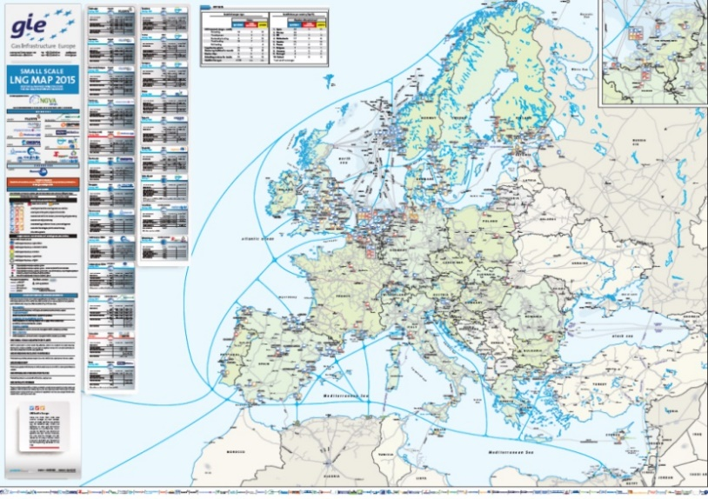
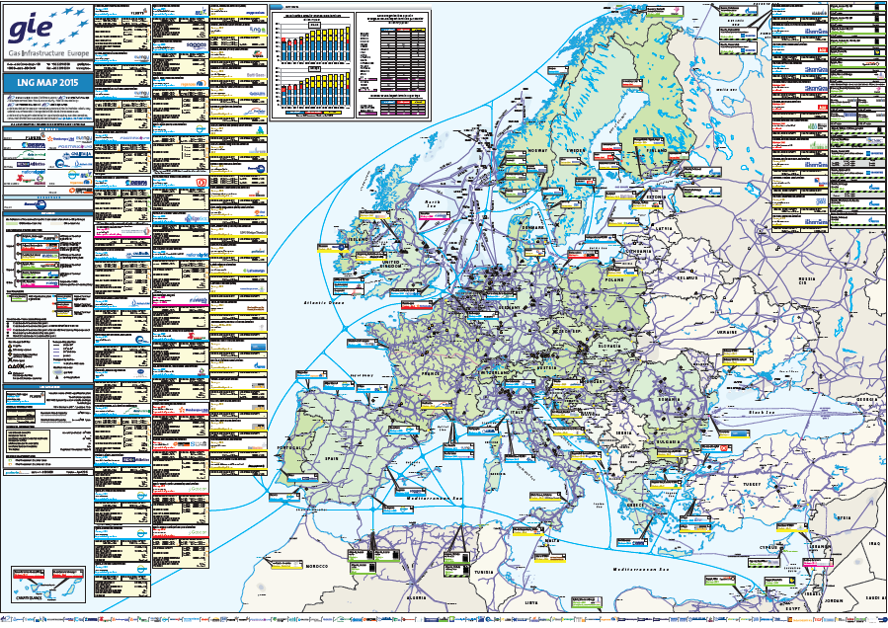
GIE services for market needs
Large Scale LNG map and database
(print version available at www.gie.eu)
Small Scale LNG map and database
(map available in October 2018)
LNG Investment database
LNG New Services Inventory
LNG List of Services
All information can be found at www.gie.eu

Slide 5
LNG makes economic sense; key figures in international LNG sector
DEMAND
(2018)
SUPPLY
(2018)
42 importing countries (+2 vs. 2017)
29 in the EU
868 MT regas capacity (+18 vs. 2017)
20% is in the EU
10% are FSRUs (24 FSRUs)
Biggest five consumers: MT, (% share):
Japan: 82.5 (26%)
China: 54 (17%)
South Korea: 44 (14%)
India: 22 (7%)
Taiwan: 17 (5%)
20 importing countries (+1 vs. 2017)
406 MT liquefaction capacity (+41 vs. 2017)
Biggest five producers: MT, (% share):
Qatar: 77 (25%)
Australia: 67 (21%)
Malaysia: 25 (8%)
USA: 21 (7%)
Nigeria: 20 (7%)
Global trade:
+9% vs. 2017

Slide 6
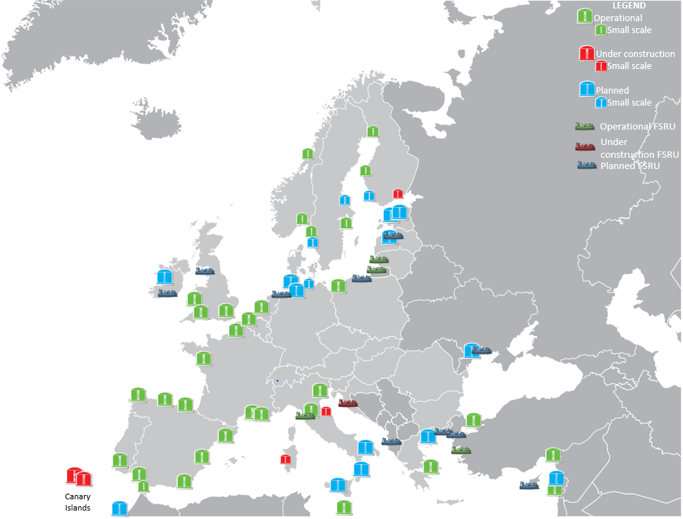
2. No issues around capacity
Number of LNG import terminals by type
 | operational | under construction (excl. expansions) | planned
Large-scale | 29 | 3 | 17
FSRUs and others | 7 | 1 | 10
Small-scale | 7 | 3 | 4
Total | 36 | 6 | 21
Annual regasification capacity of LNG import terminals (billion m³(N)/year)
 | EU 28 | Europe
operational | 212 | 241
under construction | 9 | 9
planned | 108 | 140
Detailed information about LNG terminals available at www.gie.eu, Maps & data

Slide 7
2. No issues around capacity
Terminals are well-utilised
40%
Notes:
,

Slide 8
2. No issues around capacity
Source: GLE Investment database 2019-2027

Slide 9
3. Increased services for market needs

Slide 10
4. GIE is committed to contributing to the EU Commission Paris Targets
Paris Agreement COP21 - 195 countries agreed to limit global warming to well below 2C cf 1990 temps
Challenge - net-zero carbon emissions by 2050
Problem – EU responsible for 10% global GHG emissions and energy responsible for 75% GHG emissions (and demand is growing)
Solution – decarbonised energy (gas and elec)
Affordable decarbonisation cannot be achieved without using gases
and the gas infrastructure

Slide 11
LNG helps us achieve the Paris Targets
SOx
Reduced up to 99%
Reduced up to 100%
PM
NOx
Reduced by 30% with LNG
Reduced up to 100% with biomethane and bioLNG
Reduced up to 90%
CO2

Slide 12
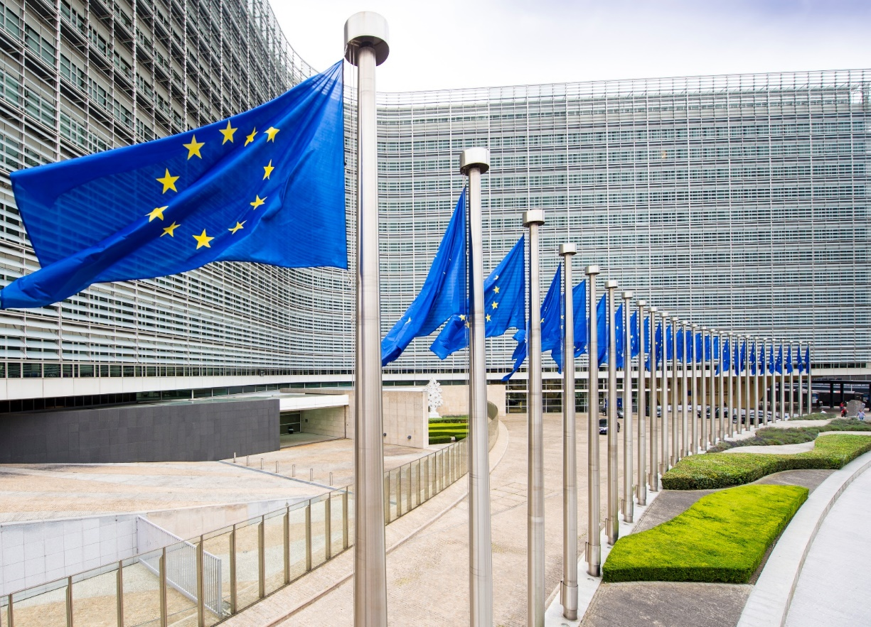
5. EU Commission is reviewing LNG
Report due 1Q19; new regulatory framework for LNG terminals in Europe?

Slide 13
GIE is proud to support
Keep it cool…with LNG
#WeDeliverParis

Slide 14
2. No issues around capacity
Notes:
Greatest jumps
Lithuania
NE
Spain
Greece

